Slide 1
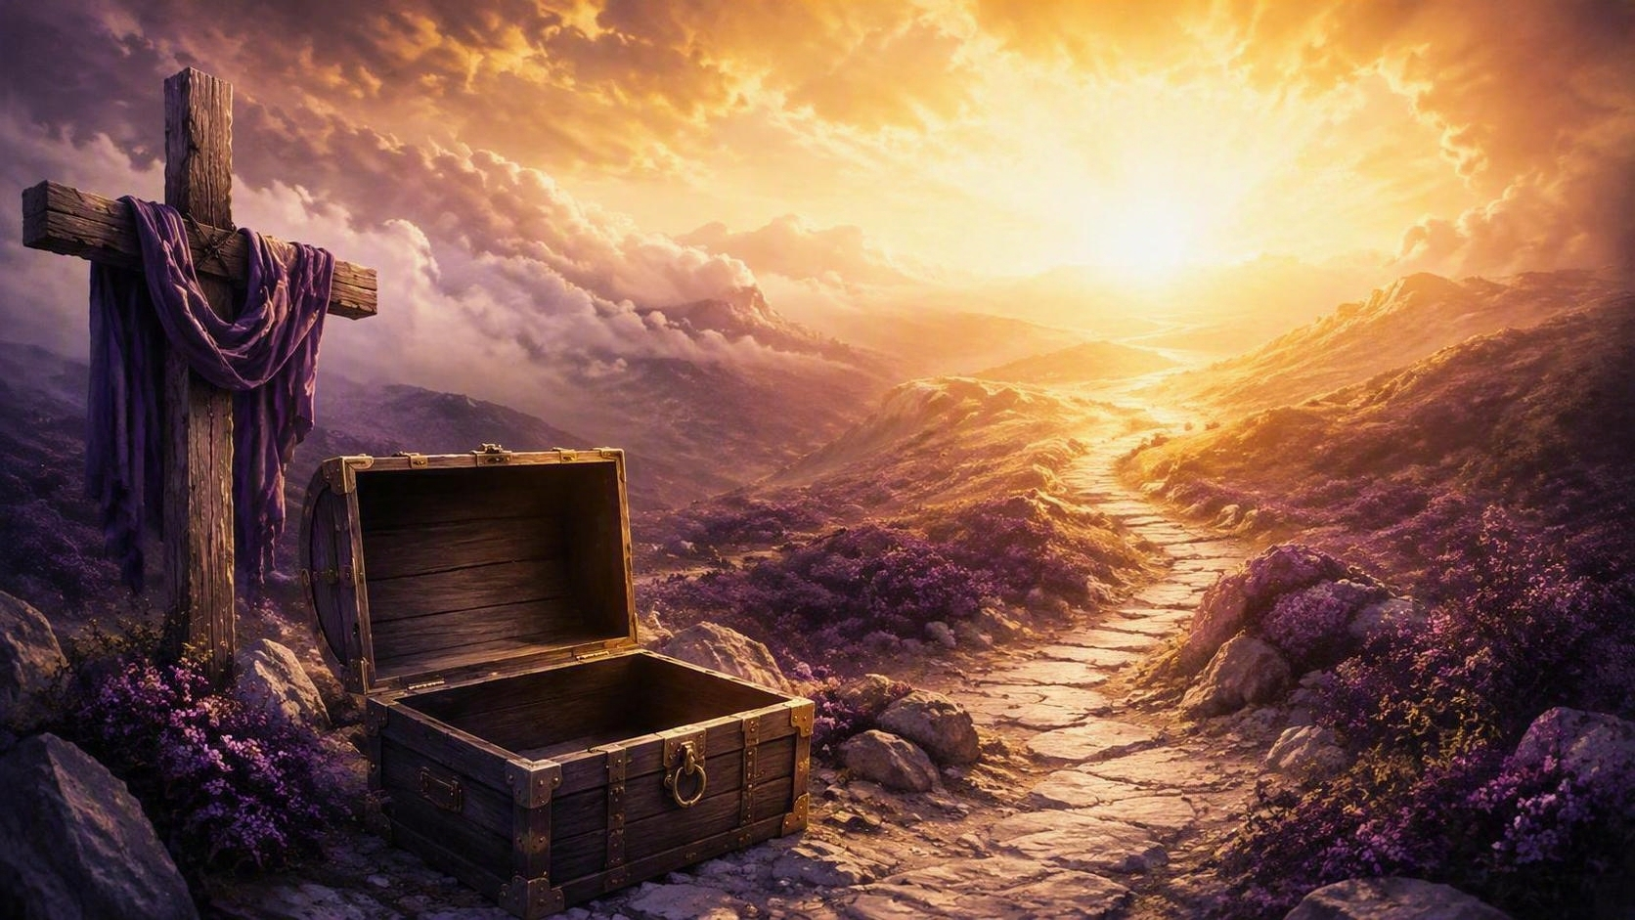
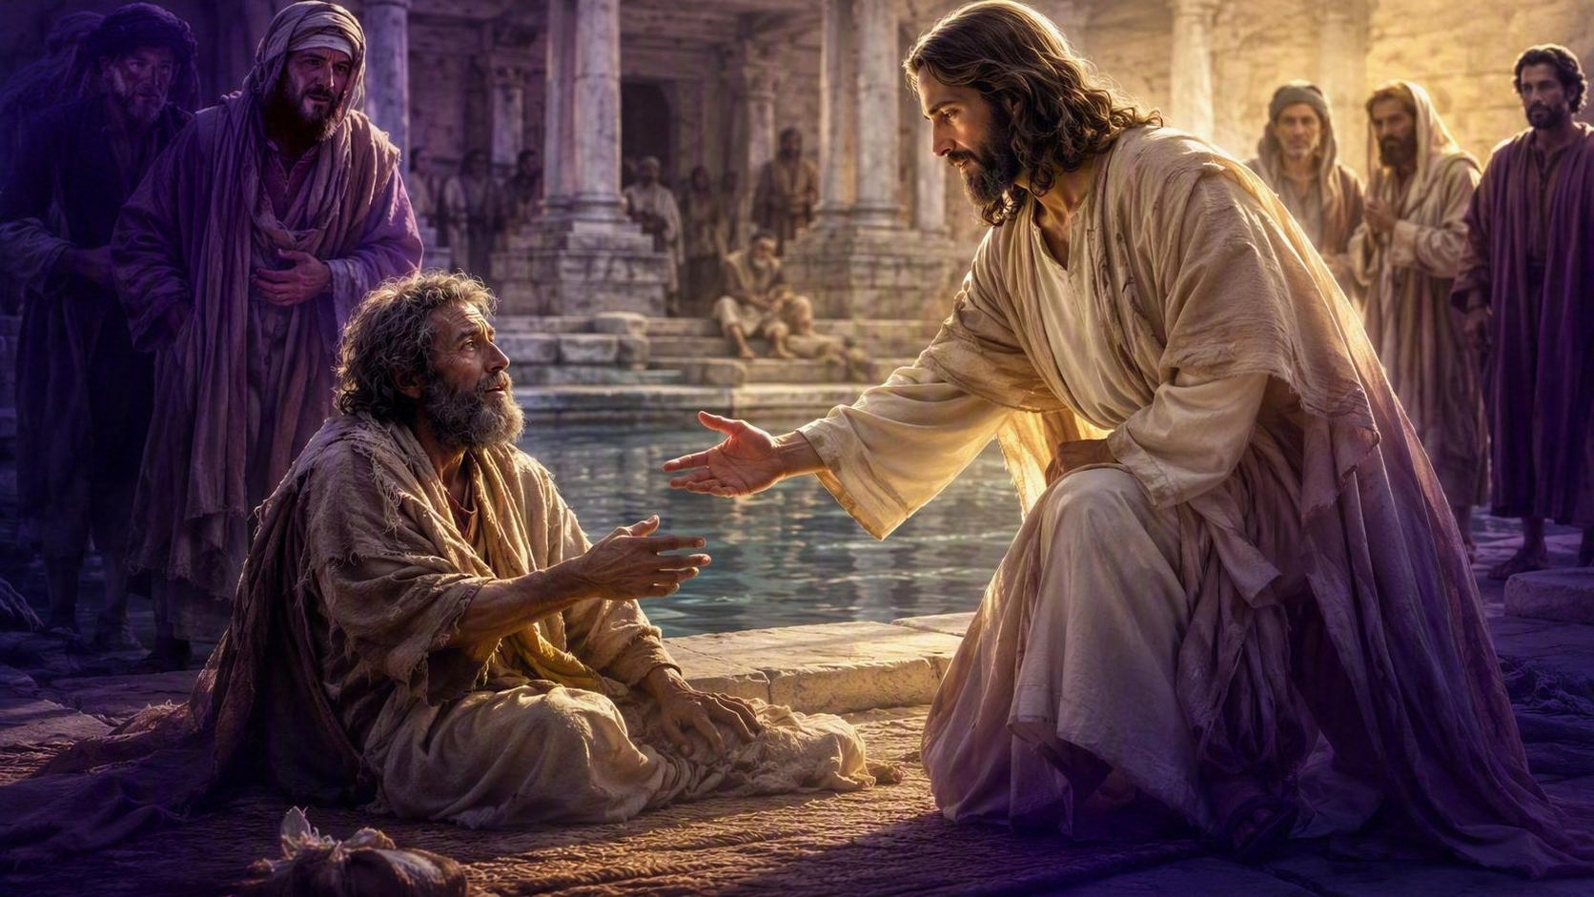
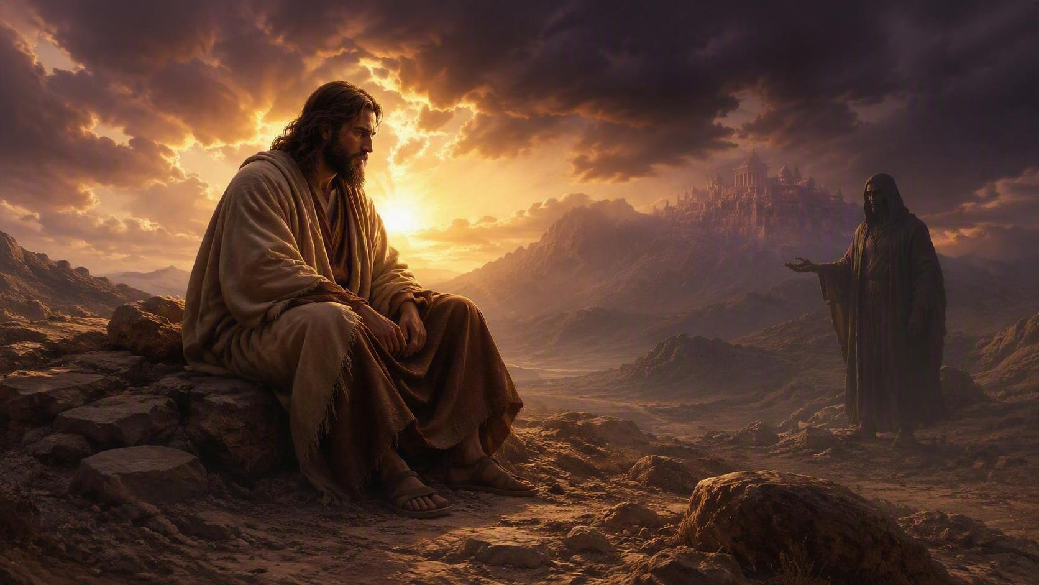
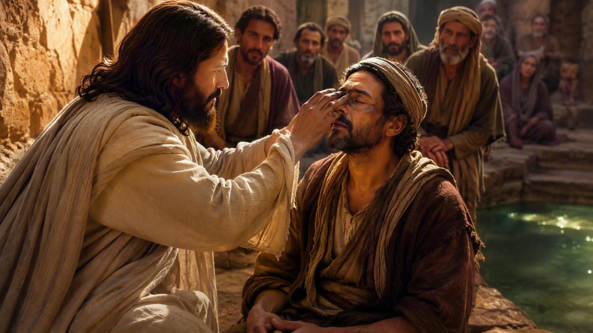
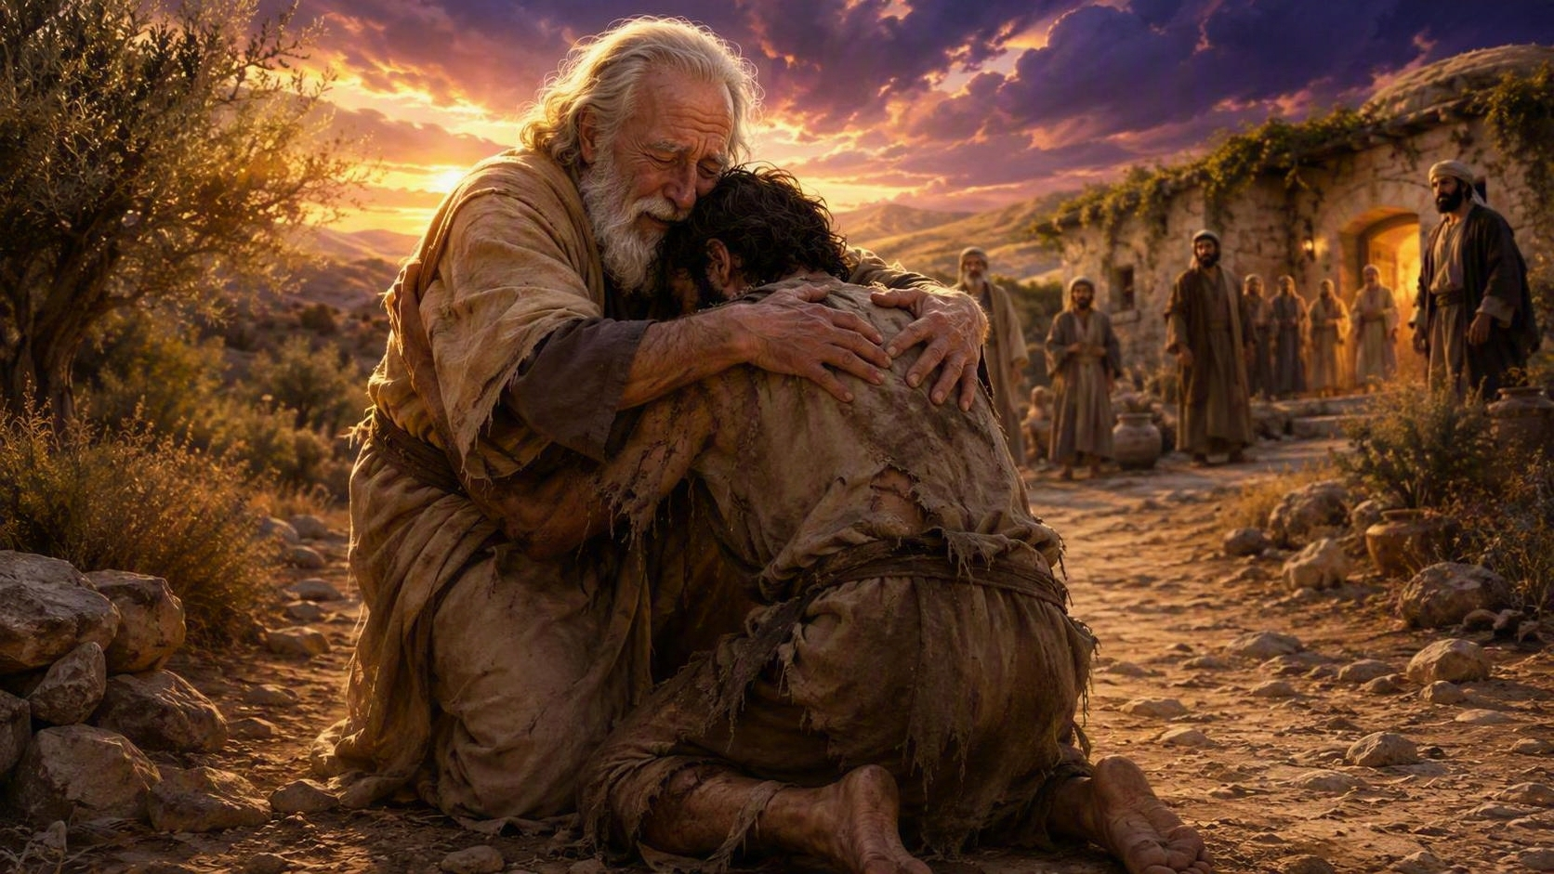
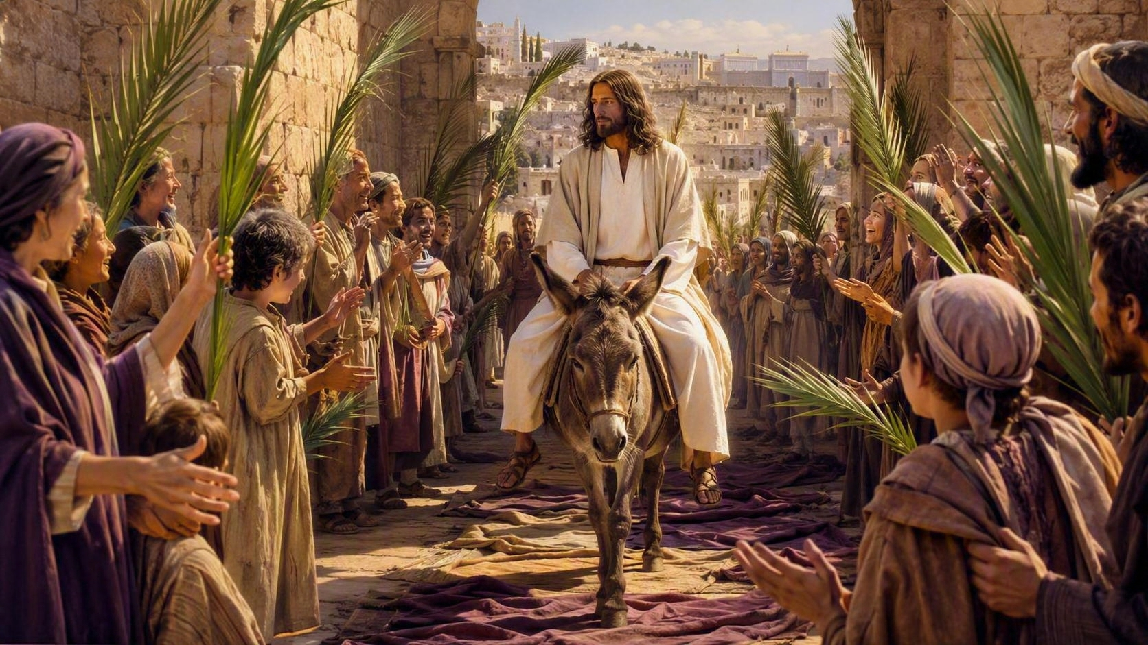
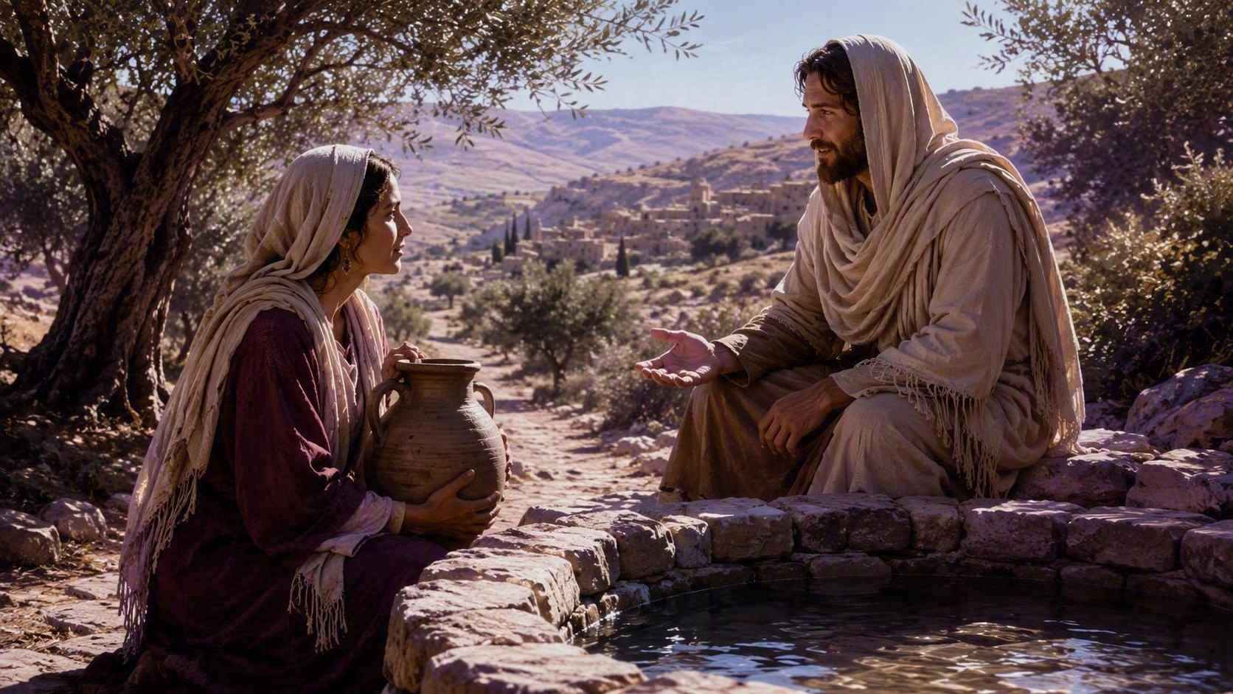
SEVEN LENTEN SUNDAYS
A Journey through lent of Reflection & Renewal
1
TREASURES SUNDAY
Matthew 6:19–33
THE PARALYZED MAN SUNDAY
Store up what lasts — seek God's kingdom first.
5
John 5:1–18
Rise and walk — your faith makes you whole.
2
TEMPTATION SUNDAY
Matthew 4:1–11
Resist the deceiver — stand firm on God's Word.
6
THE BORN BLIND MAN SUNDAY
John 9:1–41
Once I was blind — now I see the Light of the World.
3
THE PRODIGAL SON SUNDAY
Luke 15:11–32
Come home — the Father runs to welcome you.
7
PALM SUNDAY
THE SAMARITAN WOMAN SUNDAY
John 12:12–19 · Matthew 21:1–11
4
John 4:1–42
Hosanna! The King enters in humility and glory.
Living water quenches the deepest thirst.
LENT
REFLECTION
RENEWAL

